Slide 1
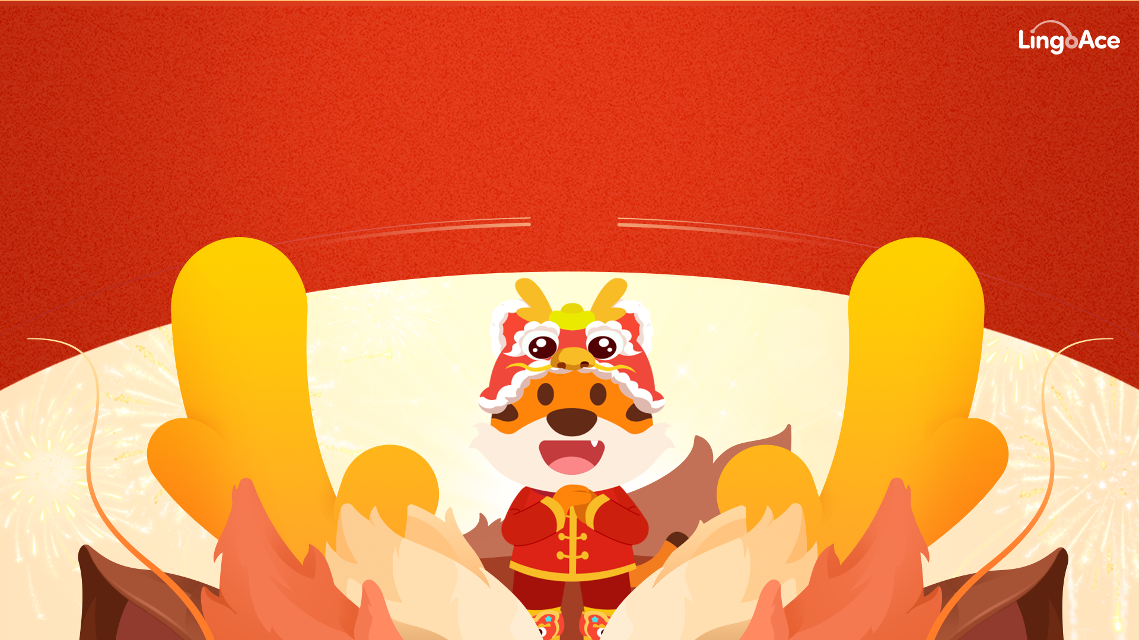
LingoAce 2024 龙🐲年特别呈现

Slide 2
Lunar New Year 2024
Celebrating the Year of the Dragon🐲 with LingoAce

Slide 3
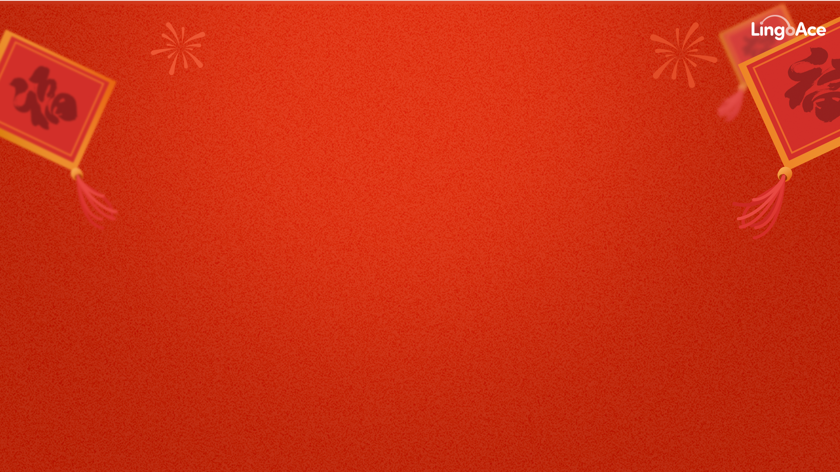

春节 | The Chinese New Year
你知道春节是什么节日吗？
春节即中国农历新年（Chinese New Year），俗称“新春”、“过年”等。春节是集除旧布新、拜神祭祖、祈福辟邪、亲朋团圆、欢庆娱乐和饮食为一体的民俗大节，与清明节、端午节、中秋节并称为中国四大传统节日。
在现代，人们把春节定于农历正月初一，但一般至少要到正月十五新年才算结束。
百节年为首、四季春为先，春节是中华民族最隆重的传统佳节。受到中华文化的影响，世界上一些国家和地区也有庆贺新春的习俗。
你知道春节有哪些习俗吗？
春节期间的庆祝活动极为丰富多样，有舞狮、飘色、舞龙、游神、庙会、逛花街、赏花灯、游锣鼓、游标旗、烧烟花、祈福、也有踩高跷、跑旱船、扭秧歌等等。
春节期间贴年红、守岁、吃团年饭、拜年等各地皆有之，但因风土人情的不同，各种活动带有浓郁的地域特色。春节民俗形式多样、内容丰富，是中华民族生活文化的精彩展示。
春
节

Slide 4
Lunar New Year
What is Lunar New Year?
Lunar New Year is a traditional Asian holiday that is also called Chinese New Year or the Spring Festival.
It celebrates the start of a new year, and is a time for honoring ancestors, praying for good fortune, reuniting with family, and eating delicious foods.
Following the traditional lunar calendar, Lunar New Year takes place between January and February. The starts on the first new moon of the year and ends 15 days later on the full moon.
Lunar New Year is celebrated by many Asian communities including Chinese, Korean, Vietnamese, and among the Chinese diaspora communities around the world.
What customs are practiced?
In Chinese culture, Lunar New Year is celebrated with lion and dragon dances, parades, temple fairs, flower street parades, lantern displays, drum performances, fireworks, and more.
During Lunar New Year, homes are decorated with red banners with a Chinese New Year greeting or poem written on it. Families will often gather on New Year's Eve for a reunion dinner, and elders will give red envelopes with money to the children in the family.
There are many wonderful regional and family variations of these traditions that evolve with each new generation.
春
节

Slide 5
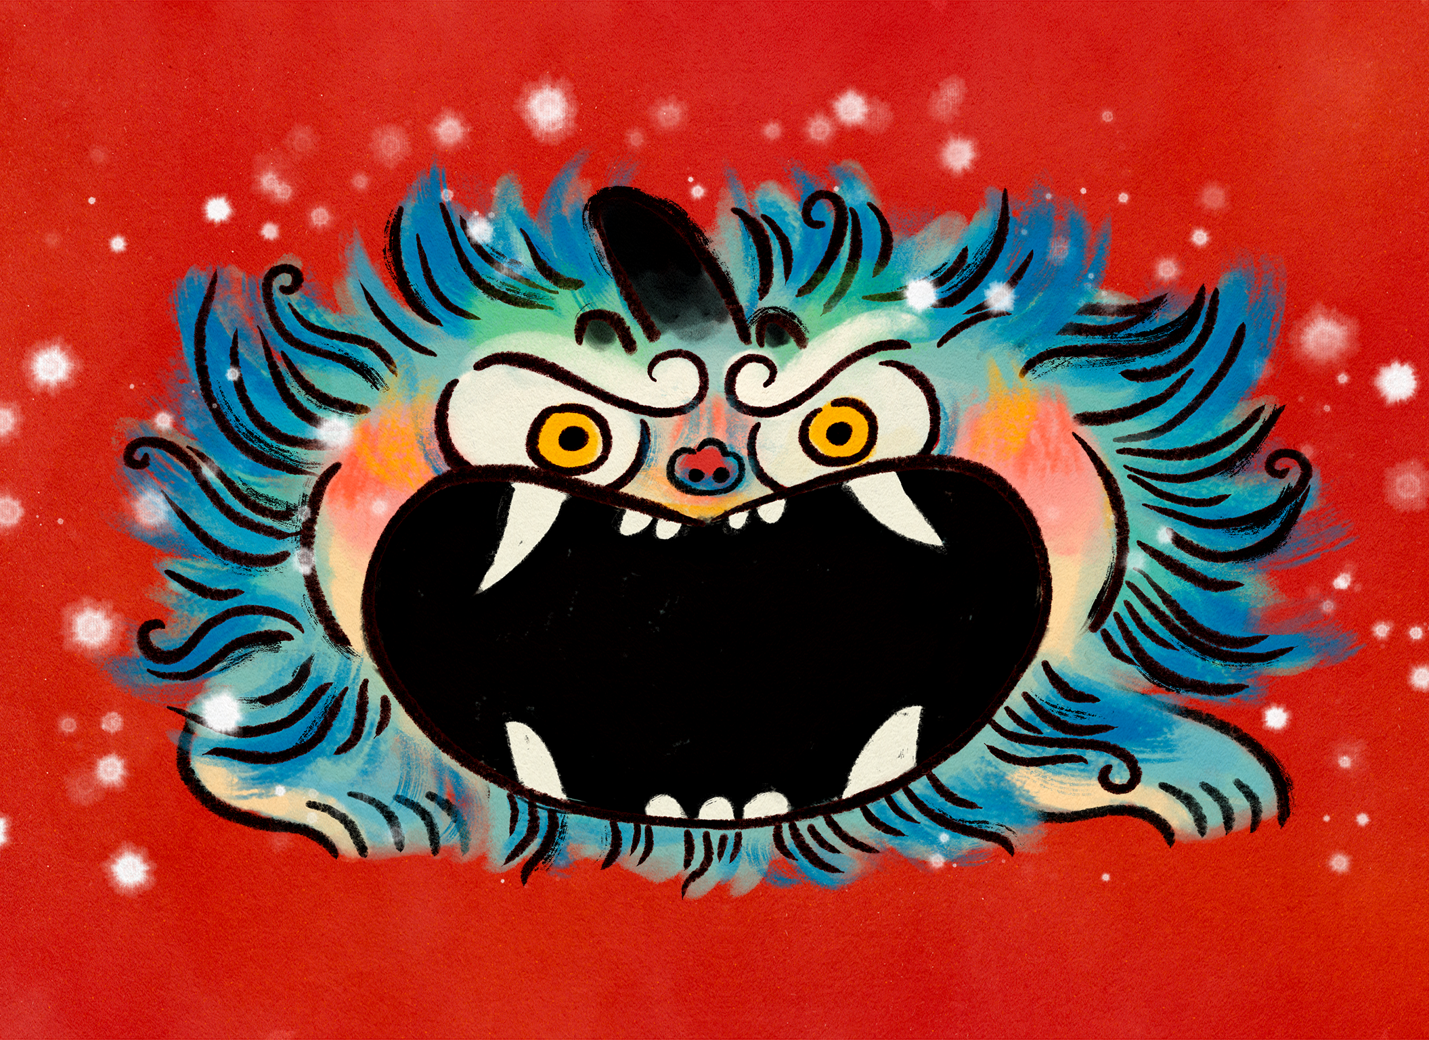
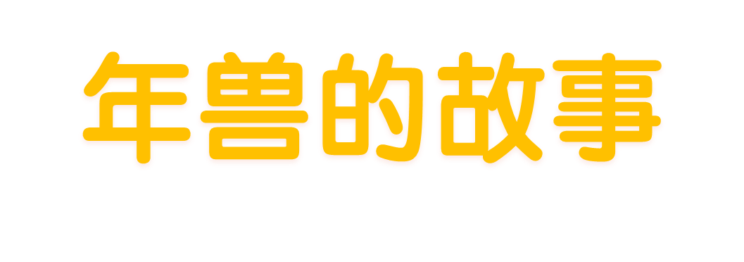
The Story of Nian

Slide 6


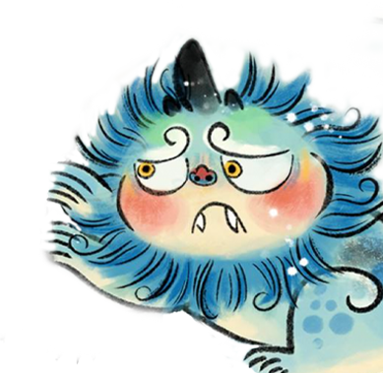
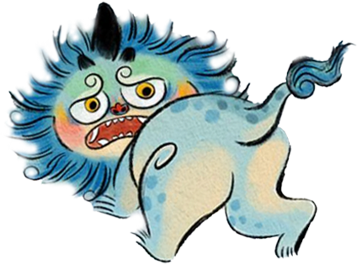
年兽和过年有什么关系？
民间传说，往往春节期间，冬天野外会出来一种叫年的野兽，年兽一年出没一次，这一日叫“过年”（年来了）。
年兽十分凶残，半夜走家串户吃人，炎黄先祖为了躲避年，举家团圆在一起，围坐在一起抵抗年兽。
因此，家家户户在门口贴上红春联，在家门口燃起篝火，放爆竹，年兽看见人家门上贴着红对联，门口有红火燃起，爆竹霹雳乱响，还会和长辈拜年，就赶走了年兽。人们高兴地互道：“又熬过一个年了！”慢慢的就有了过年的说法。
年兽每年出没一次，炎黄先祖在无数次斗争中，摸索出了诀窍，他们发现年兽虽猛，但惧怕红色、火光和巨响。

Slide 7
The Story of Nian the New Year Monster
This fight against Nian later evolved into the Lunar New Year traditions we practice today. Chinese families put up red banners on their doors, light lanterns, and set off firecrackers and fireworks to symbolically drive away the monster.
There’s even a New Year’s greeting in Chinese that references this story: "We've survived another year!"
According to ancient folklore, a monster called Nian (which means “year” in Chinese) would appear once a year to terrorize villagers. Families would gather to form a united front and protect each other from the monster.
After numerous struggles, the villagers eventually discovered Nian’s weakness. The monster was afraid of the color red, firelight, and loud noises.

Slide 8

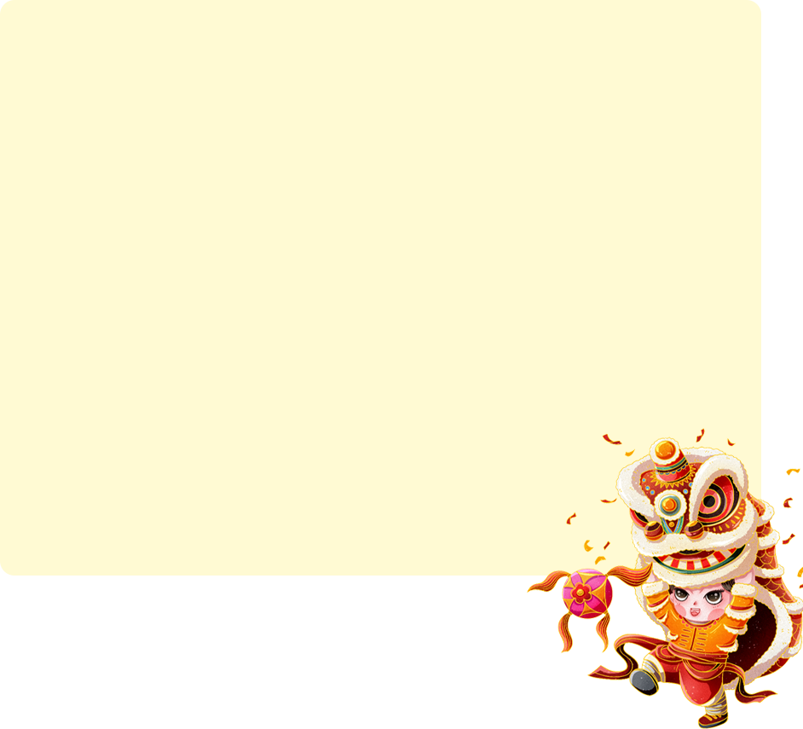
为什么说今年是龙年？
首先你要知道什么是十二生肖
最开始十二生肖的由来，主要是为了计算年号的，用十二种动物来计算每一年的年号，方便人们知道时间和年份的变化。因为古代的人更喜欢用腾图来标记，故而选择了在众多的动物之中，选择了是十二种动物来作为十二生肖，来定做年号。
根据天干地支计算方法，2024年属于龙年。在中华文化中，龙象征着吉祥、繁荣和生机，因此龙年被认为是一个充满希望和机遇的年份。2024年也是自1896年以来第三个连续的闰年龙年，被称为“青龙年”，这在民间被认为是一个特别吉祥的年份，人们期待在青龙年中迎接好运和成功。
十二生肖的顺序是：子鼠、丑牛、寅虎、卯兔、辰龙、巳蛇、午马、未羊、申猴、酉鸡、戌狗、亥猪。

Slide 9
Why is 2024 the Year of the Dragon?
Chinese Zodiac
Unlike the Western zodiac, which is based on the sun's position at the time of one's birth, the Chinese Zodiac operates on a twelve-year cycle. Each year is represented by an animal. This was originally developed as a way to track changes in time and years on the Lunar calendar.
2024 is the year of the dragon. In Chinese culture, the dragon symbolizes auspiciousness, prosperity, and vitality. Dragon years are considered exceptionally auspicious, and people are especially hopeful for good luck and success.
12 Chinese zodiac animals: Rat, Ox, Tiger, Rabbit, Dragon, Snake, Horse, Ram, Monkey, Rooster, Dog, Pig.

Slide 10
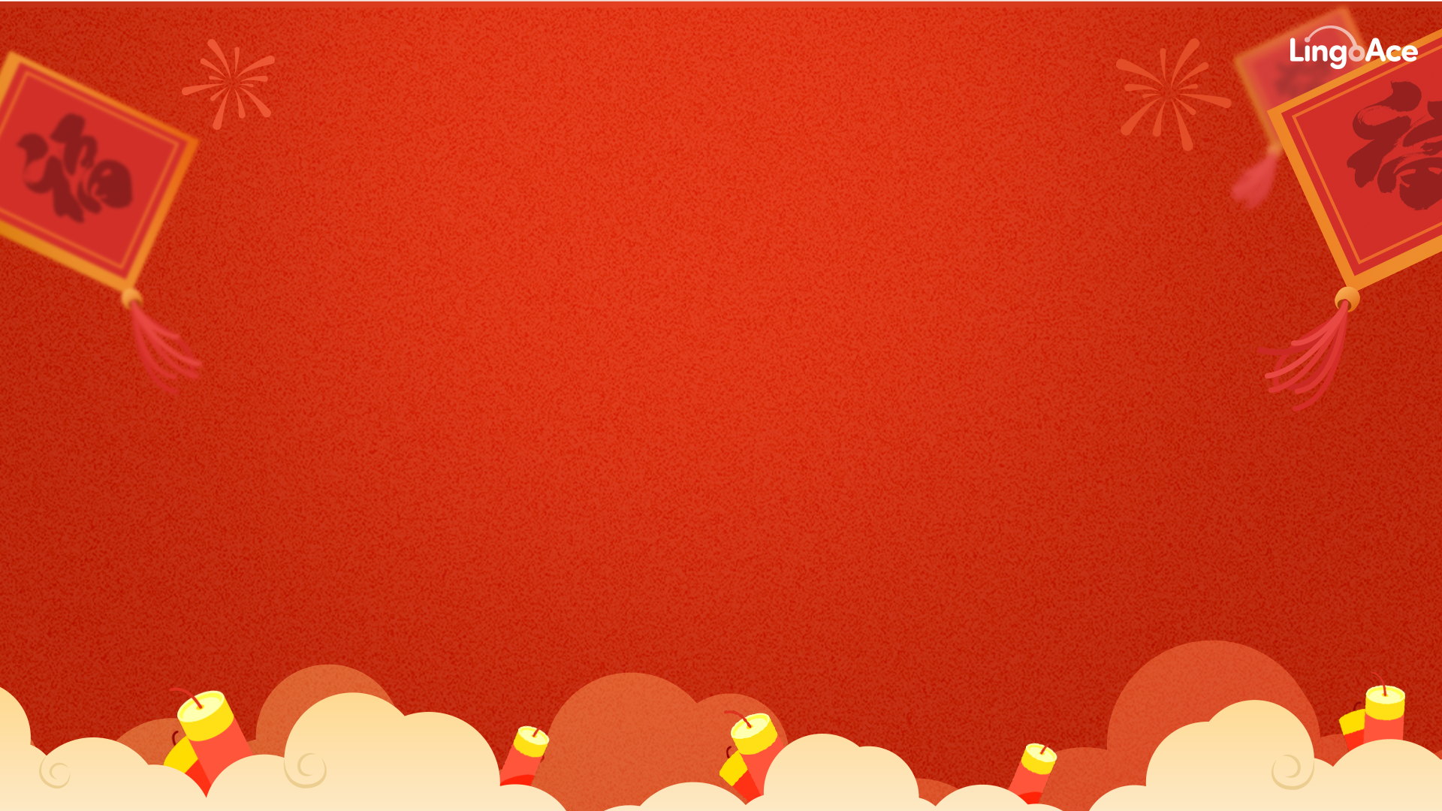

那龙年要送什么拜年祝福呢？
龙腾虎跃：lóng téng hǔ yuè
  意思是像龙在飞腾，虎在跳跃，形容跑跳时动作矫健有力，也比喻奋起行动，有所作为。
龙马精神：lóng mǎ jīng shén
  意思是比喻人旺盛的奋发向上的精神和样子。
龙年大吉： lóng nián dà jí
  祝对方龙年一切顺利，吉祥如意
备注：可以加一些鞭炮，用红色卷轴等形式呈现祝语
更多中文资料请点击：lingoace.com
更多中文资料请点击：www.lingoace.com

Slide 11
Let’s learn dragon expressions in Chinese
龙腾虎跃 (lóng téng hǔ yuè): Dragons Soar, Tigers Leap
  Using two powerful animals, this idiom is used to describe a vibrant and successful future.
龙马精神 (lóng mǎ jīng shén): Dragon and Horse Spirit
  This idiom describes someone with a robust and lively spirit.
龙年大吉 (lóng nián dà jí): Good Fortune in the Year of the Dragon
  This is a New Year’s greeting that expresses hope and good luck during a dragon year.
Learn More www.lingoace.com

